Slide 1
Linear algebra

Slide 2
Introduction
In this topic, we will
Look at how floating-point numbers can seriously affect the results of Gaussian elimination and backward substitution
Describe the Gaussian elimination algorithm with partial pivoting
Look at the Jacobi method for approximating the solution to a system of linear equations using iteration
Describe the condition number of a matrix

Slide 3
Linear algebra
Systems of linear equations are often the only ones that can be approximated numerically with reasonable certainty
Many non-linear systems are often approximated using linear systems
For example, small-signal analysis of non-linear devices
The modelling of objects with momentum can generally be done locally in time by linear approximations
This of course fails if, for example, an object strikes another object

Slide 4
Linear algebra
Consider a system of n linear equations in n unknowns
Au = v
To solve such a system, we:
Create the augmented matrix
We apply row operations on the augmented matrix until the matrix is in row-echelon form
The three elementary row operations are:
Swapping two rows
Adding a multiple of one row onto another
Multiplying a row by a non-zero scalar
The first two are used for this process of Gaussian elimination
If rank( A ) = n, we may use backward substitution to find the unique solution

Slide 5
Issues with linear algebra
Issues:
If the matrix A is dense, the number of floating-point operations (flops) can be as high as
Many times, in adding a multiple of one row onto another, there is the possibility of subtractive cancellation
Additionally, if we are adding a large multiple of one row onto another, we may end in the situation where x + y = y

Slide 6
Issues with linear algebra
Consider the following system:
By observation, the solution should be close to
The exact solution is
To four significant digits, this is

Slide 7
Issues with linear algebra
Now, applying Gaussian elimination:
Add –100 000 times Row 1 onto Row 2, resulting the calculations:
–100 000 + 1 = –99 999
–100 000 + 2 = –99 998
Thus, we are left with
Thus u₂ = 1
Substituting this into Row 1, we get that u₁ = 0
= –541000
= –541000

Slide 8
Issues with linear algebra
Thus, while the best answer is
Gaussian elimination and backward substitution gave us
What happened?
When we added a huge multiple of Row 1 onto Row 2, this had the effect of swamping out Row 2
Recall that a_{2, j} + ca_{1, j} = ca_{1, j} if ca_{1, j} >> a_{2, j}
Consequently, the matrix ended up looking like:

Slide 9
Partial pivoting
Thus, by adding a large multiple of one row onto another, we lost all information about that second row
Recall in linear algebra, if you had a zero in the pivot position, you’d swap two rows:
Gaussian elimination with partial pivoting says to swap the row with the largest-in-magnitude entry on or below the pivot to the pivot row

Slide 10
Partial pivoting
Applying this here, we would now have:
Adding –0.00001 times Row 1 onto Row 2 now leaves Row 2 unchanged:
Applying backward substitution, gives us that

Slide 11
Gaussian elimination with partial pivoting
Thus, you could describe the Gaussian elimination algorithm where A:R^{n} → R^{m} so that A is an m × n matrix as follows:
Create the m × (n + 1) augmented matrix
Assign i ← 1 and j ← 1
While j ≤ n + 1,
If Column j contains no leading non-zero entries, update j ← j + 1 and return to Step 3.
Find the row with the largest-in-magnitude non-zero leading entry in Column j (if there are multiple such entries, pick one), and swap that row with Row i
For each other Row k that has a leading non-zero entry in Column j, add times Row i onto Row k
Update i ← i + 1 and j ← j + 1; and return to Step 3.

Slide 12
Gaussian elimination with partial pivoting
Why does this help?
If the largest entry in absolute value is moved to the pivot, then when we add a multiple of one row onto another, we are guaranteed that
Thus, in general, we will avoid the issue of adding a significant multiple of one row onto another

Slide 13
Gaussian elimination with partial pivoting
For example, suppose we are to solve

Slide 14
Gaussian elimination with partial pivoting
First, we create the augmented matrix:

Slide 15
Gaussian elimination with partial pivoting
Starting in the first column, the largest entry in absolute value on or below entry (1, 1) is 5 in Row 3
Swap Rows 1 and 3

Slide 16
Gaussian elimination with partial pivoting
Now, add appropriate multiples of Row 1 onto Rows 2, 3 and 4:
Add –4/5 = –0.8 times Row 1 onto Row 2
Add –(–1.5)/5 = 0.3 times Row 1 onto Row 3
Add –3/5 = –0.6 times Row 1 onto Row 4

Slide 17
Gaussian elimination with partial pivoting
Continuing in the second column, the largest entry in absolute value on or below entry (2, 2) is 6 in Row 4
Swap Rows 2 and 4

Slide 18
Gaussian elimination with partial pivoting
Now, add appropriate multiples of Row 2 onto Rows 3 and 4:
Add –(–5.4)/6 = 0.9 times Row 2 onto Row 3
Add –2.4/6 = –0.4 times Row 2 onto Row 4

Slide 19
Gaussian elimination with partial pivoting
Continuing in the third column, the largest entry in absolute value on or below entry (3, 3) is –10 in Row 4
Swap Rows 3 and 4

Slide 20
Gaussian elimination with partial pivoting
Now, add an appropriate multiple of Row 3 onto Row 4:
Add –7/(–10) = 0.7 times Row 3 onto Row 4

Slide 21
Gaussian elimination with partial pivoting
We can now use backward substitution to find the solution:

Slide 22
Iteration
In Matlab, you can do this as follows:
>> A = [-1.5 -6.0 5.8 7.0 4.0 4.0 -8.8 -1.6 5.0 2.0 1.0 -1.0 3.0 7.2 1.6 2.4];
>> v = [12.7 -34.4 8.0 -12.2]';
>> u = A\v
ans =
1
-2
4
-3

Slide 23
Iteration
Why use \ as an operator?
1
1
A
u =
v
A
A

Slide 24
Gaussian elimination with partial pivoting
Question:
Suppose we followed the rules of Gaussian elimination, and one of the “largest entries in magnitude” we found was very small relative to other diagonal entries
Is the original matrix A still invertible?
We’ll discuss this later…

Slide 25
Iteration
Recall the fixed-point theorem:
If we are trying to solve x = f (x), one technique is to start with an initial approximation x₀ and then iterate x_{k+1} = f (x_{k}) until either
This sequence appears to converge
Successive values are close enough
A maximum number of iterations has occurred
Sometimes, it is possible to rewrite an equation so that it is in this form:
This can be rewritten as either
You don’t have to
know how to find
these

Slide 26
Iteration
Now, take a look at this equation:
It is not of the form
Can we rewrite it?

Slide 27
Iteration
There are some properties of matrices that are seen in engineering:
Matrices may be strictly diagonally dominant
That is, each diagonal entry is greater than the sum of the absolute values of all other entries in their rows or their column columns
This ensures that the diagonal entries are all non-zero
It also guarantees the matrix is invertible
Of these two matrices, the right is diagonally dominant

Slide 28
Iteration
Consider this equation:
We can rewrite A as the sum of a diagonal matrix and an off-diagonal matrix
For example,

Slide 29
Iteration
Thus, we may rewrite this equation
From linear algebra, you know that (A + B)u = Au + Bu
Thus
The problem is, we still need to isolate a u…

Slide 30
Iteration
Of these two matrices, which is invertible?
If you said “both”, you’re right, but how?
After all, this matrix is singular (not invertible):

Slide 31
Iteration
From linear algebra, a diagonal matrix is invertible if and only if all the diagonal entries are non-zero
The inverse of an invertible diagonal matrix is that matrix with the reciprocals of the diagonal entries
Recall that if A is invertible, then u = A^{–1}v solves Au = v
Normally, we don’t want to find the inverse, but for diagonal matrices, it is a numerically safe operation

Slide 32
Iteration
Question:
Is this matrix still invertible?
We’ll discuss this later…

Slide 33
Iteration
Okay, so given this derivation:
The diagonal matrix is invertible, so:
Bring the vector A_{off} u to the other side:
Multiply both sides by the inverse of A_{diag}:

Slide 34
Iteration
Thus, we have now transformed
into the equivalent equation
This is of the form u = f(u)
Thus, if we find a solution to the second, that solution is also a solution to the first

Slide 35
Iteration
This is not something to do by hand, so let us go to Matlab:
>> A = [20.0 0.3 -0.4 0.5 0.1 5.0 1.2 -0.3 0.7 0.2 4.0 -1.1 0.4 1.3 0.6 10.0];
>> v = [0.3 0.5 -0.2 0.4]';
>> u = A\v
u =
0.01160226827793914
0.1134499024722330
-0.05006035517628202
0.02779104325806907
>> Adiag = diag( diag( A ) );
>> Aoff = A - Adiag;
>> InvAdiag = inv( Adiag );

Slide 36
Iteration
>> f = @(u)( InvAdiag*(v - Aoff*u) );
>> u0 = InvAdiag*v; % Solution to Adiag u0 = v
>> for k = 1:100 previous_u0 = u0; u0 = f( u0 );
if norm( u0 - previous_u0 ) < 1e-6
u0
break;
end
end
u0 =
0.01160226317322344
0.1134498919522636
-0.05006031299952349
0.02779101753556567
>> k
k = 8
>> norm( u0 - u );
5.076666249750968e-08
u =
0.01160226827793914
0.1134499024722330
-0.05006035517628202
0.02779104325806907

Slide 37
Iteration
This is called the Jacobi method
It is guaranteed to converge to a solution if the matrix is strictly diagonally dominant
In other cases, it may diverge, even if the matrix is only diagonally dominant
Later, we will see a variation called the Gauss-Seidel method

Slide 38
Iteration
Question:
Which should we choose?
The first requires an O(n) calculation each iteration
The second requires an O(n + n²) calculation up front
If the number of iterations is significantly less than the number of equations, we should use the first

Slide 39
Ill-conditioned systems
We have covered how to minimize numeric error when solving a system of linear equations
There are systems, however, that are inherently numerically unstable
One problem in engineering is that nothing is exact:
There are errors in the matrix A
There are errors in the target vector v
There are round-off errors and errors due to subtractive cancellation
Can these errors be magnified in u?
Can we accidentally design a system that is ill-conditioned

Slide 40
Ill-conditioned systems
Consider this matrix:
The determinant is one: det(A) = 1
If , the solution to Au = v is

Slide 41
Ill-conditioned systems
What happens if there is an error in the matrix?
The solution to is
Recall that the solution to Au = v was
The relative error is or 15300%

Slide 42
Ill-conditioned systems
Consider this matrix:
If , the solution to is
Recall that the solution to Au = v was
A relative error of in the target vector
results in the relative error of in the solution

Slide 43
Ill-conditioned systems
In first year, you were repeatedly told to check if the determinant was non-zero when checking for invertibility
Unfortunately, due to numeric error, the determinant of even clearly non-invertible matrices is non-zero
Consider
>> B = [1 2 3; 4 5 6; 7 8 9];
>> det( B )
ans =
-9.5162e-16
>> 2*B(:,2) - B(:,1)
ans =
3
6
9

Slide 44
Ill-conditioned systems
What is better to check are the singular values
Specifically, the ratio between the largest singular value and the smallest singular value
The largest singular value is the most a matrix stretches the norm of a vector
The smallest singular value is the least a matrix stretches the norm of a vector
>> A = [4 -3 4; 2 4 3; 3 3 4];
>> svd( A )
ans =
8.5702
5.5274
0.0211

Slide 45
Ill-conditioned systems
Suppose a 3 × 3 matrix A has rank(A) = 2
The matrix is not invertible
The image of the unit sphere will be an ellipse centered at the origin on a plane passing through the origin
Suppose now 3 × 3 matrix A has rank(A) = 3, but where the image of the unit sphere is now pancake shaped
In our example,
The sphere is stretched by a factor of almost 10
In another perpendicular direction by a factor of 5
In another perpendicular direction it is shrunk by a factor of 50
The matrix is invertible, but it is close to a matrix that is not

Slide 46
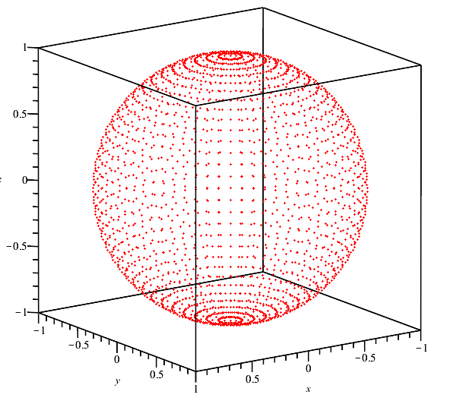
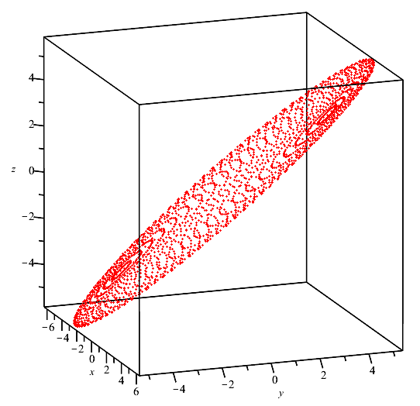
Ill-conditioned Systems
This matrix is not invertible, and the image of the unit sphere is an ellipse in R³

Slide 47
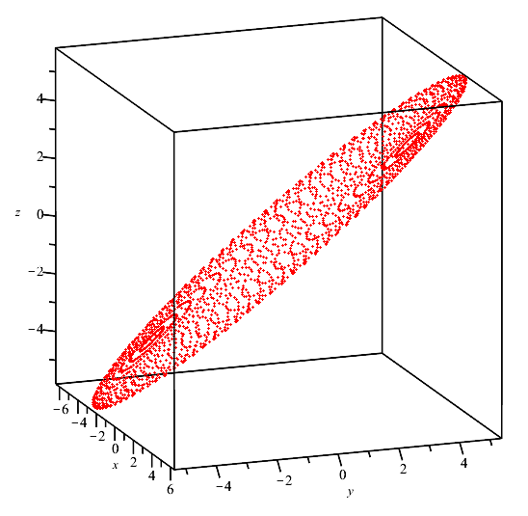
Ill-conditioned Systems
This matrix is invertible, but very close to the previous matrix

Slide 48
Ill-conditioned systems
This ratio between the largest and smallest stretch is called the condition number and it describes the maximum increase in the relative error when solving a system of linear equations
>> A = [4 -3 4; 2 4 3; 3 3 4];
>> cond( A )
ans =
405.9726
>> format hex
>> A \ [5 9 10]'
ans =
3ff0000000000019
3ff0000000000004
3fefffffffffffd4
…000000011001
…000000000100
…111111010100
You don’t have to know how to calculate the condition number

Slide 49
Ill-conditioned systems
The larger the condition number:
The larger small errors in the matrix will be magnified
The larger small errors in the target vector will be magnified
The larger round-off error and effects of subtractive cancellation will be magnified
For the purposes of this course, you must simply be aware that a large condition number suggests you must consider how sensitive your system is to errors in the implementation
You don’t have to know how to calculate the condition number

Slide 50
Summary
Following this topic, you now
Understand that solving a system of linear equations may result in significant errors
Understand that the Gaussian elimination algorithm with partial pivoting reduces the effect of such errors
Have seen the Jacobi method, where we approximate a solution to a system of linear equations using iteration
Are aware of the condition number of a matrix
You do not need to know how to calculate the condition number

Slide 51
References
[1] https://en.wikipedia.org/wiki/Gaussian_elimination
[2] https://en.wikipedia.org/wiki/Pivot_element
[3] https://en.wikipedia.org/wiki/Jacobi_method
[4] https://en.wikipedia.org/wiki/Condition_number

Slide 52
Acknowledgments
Tazik Shahjahan for pointing out typos.
Hassaan Ali Qazi for suggesting showing the images of the unit sphere under the two matrices, one ill-conditioned, the other non-invertible.

Slide 53
Colophon
These slides were prepared using the Cambria typeface. Mathematical equations use Times New Roman, and source code is presented using Consolas. Mathematical equations are prepared in MathType by Design Science, Inc.
Examples may be formulated and checked using Maple by Maplesoft, Inc.
The photographs of flowers and a monarch butter appearing on the title slide and accenting the top of each other slide were taken at the Royal Botanical Gardens in October of 2017 by Douglas Wilhelm Harder. Please see
https://www.rbg.ca/
for more information.

Slide 54
Disclaimer
These slides are provided for the ece 204 Numerical methods course taught at the University of Waterloo. The material in it reflects the author’s best judgment in light of the information available to them at the time of preparation. Any reliance on these course slides by any party for any other purpose are the responsibility of such parties. The authors accept no responsibility for damages, if any, suffered by any party as a result of decisions made or actions based on these course slides for any other purpose than that for which it was intended.

